Slide 1



Tom Colarusso
@etcolarusso
@acvauctions
www.acvauctions.com

Slide 2

A Vue To A Kill
From AngularJS To Vue.js

Slide 3
How we got here...

Slide 4
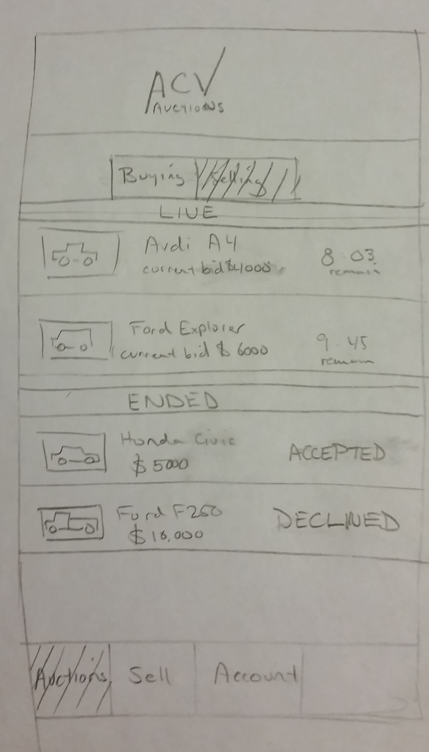
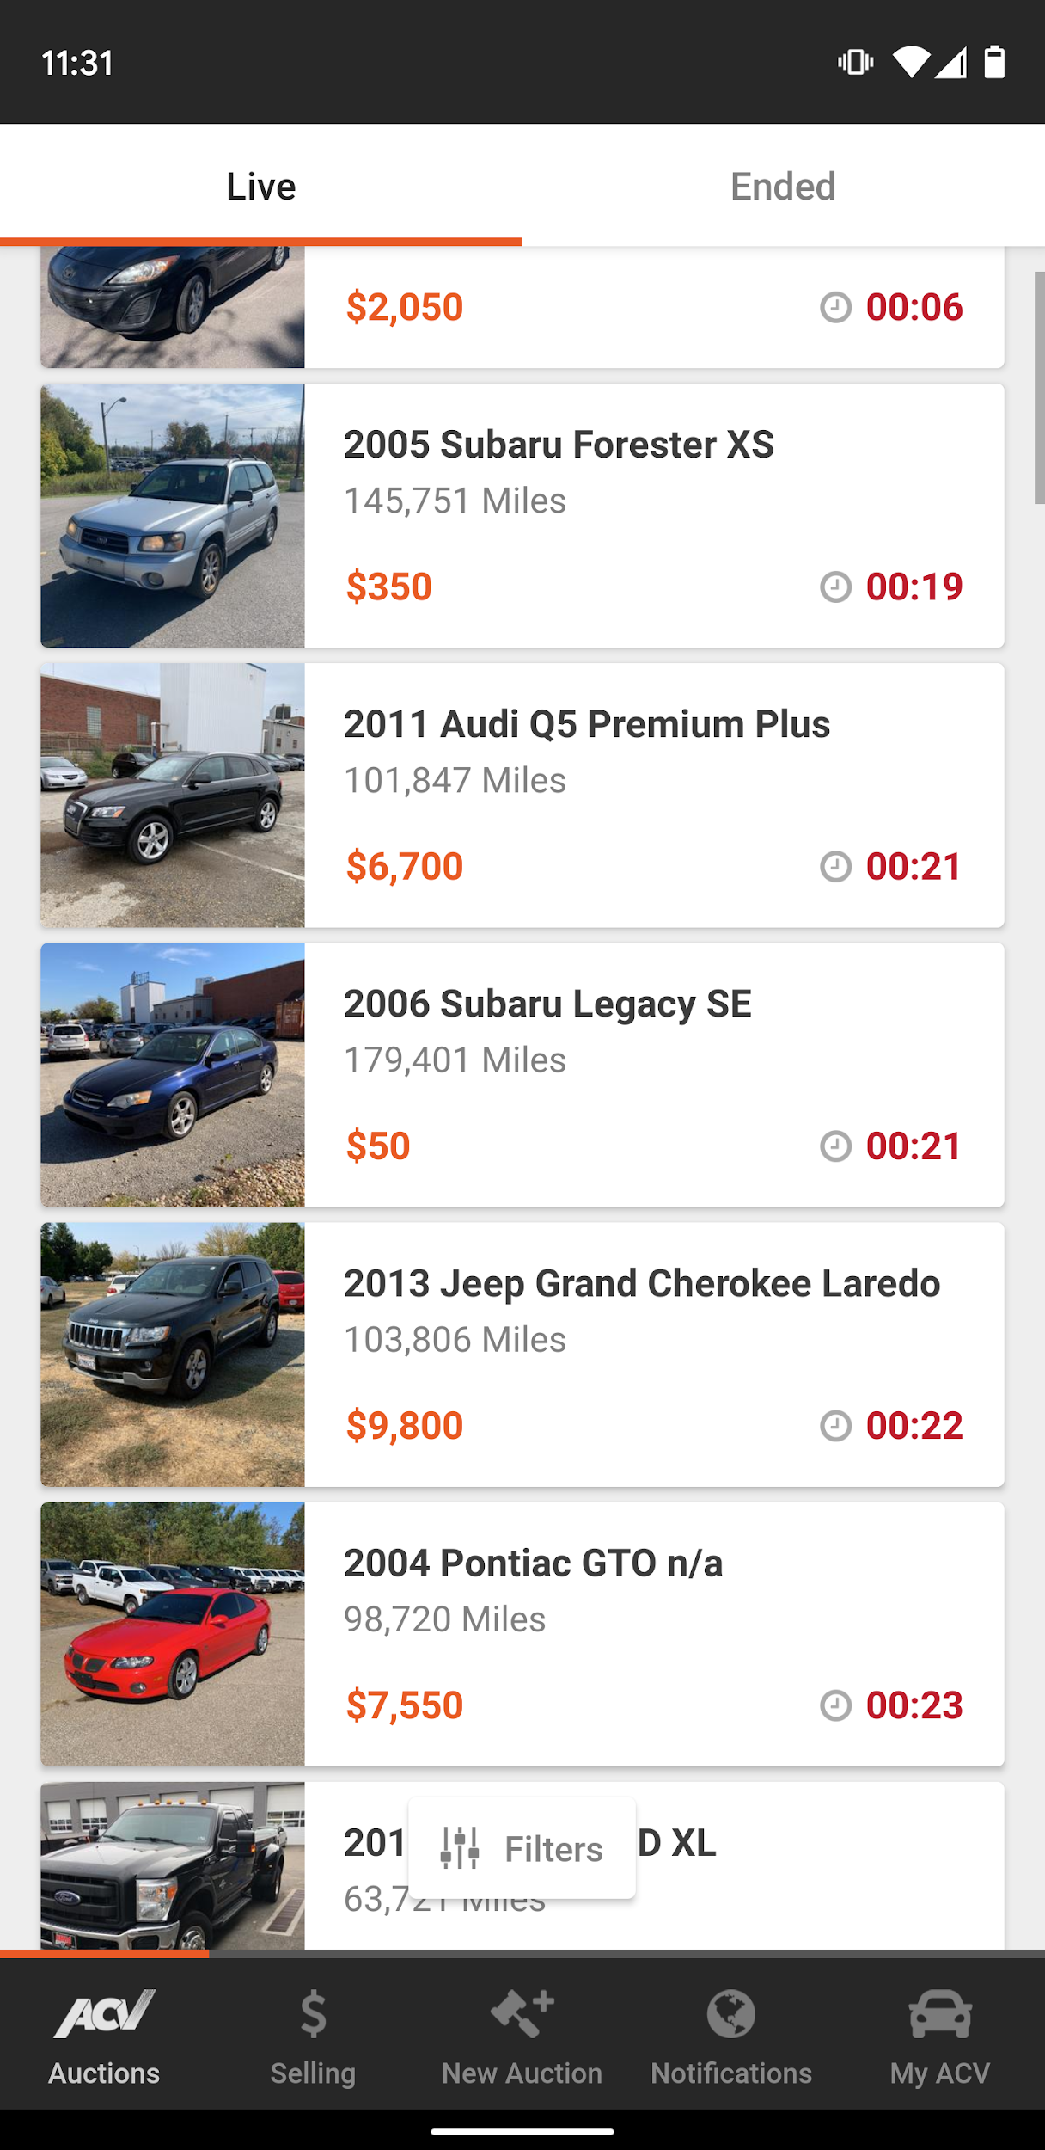
A brief history
Company founded 2014
  Launched 2015
Dealer to Dealer automobile auctions
  No consumer facing product.
20 minute durations
Initially only offered Titanium app
  iOS
  Android
Backend built on Perl and Node.js
No Web product beyond registration

Slide 5
A brief history
Customers requested a web site
  Multitasking
    Researching vehicles.
    Bidding on multiple vehicles.
  Older demographic
  Faster iteration on updates
  Faster conversion rate

Slide 6
A brief history
The Legacy Angular App
  AngularJS 1.4
  AuctionHouse SDK
    JavaScript Library
    Powered the Titanium Apps
  PHP Middle Tier
    Serve static assets
    Session data
    Proxy to Backend API

Slide 7


The Dreaded ‘R’ Word...
Your product manager
REWRITE!

Slide 8

To rewrite or not to rewrite.

Slide 9
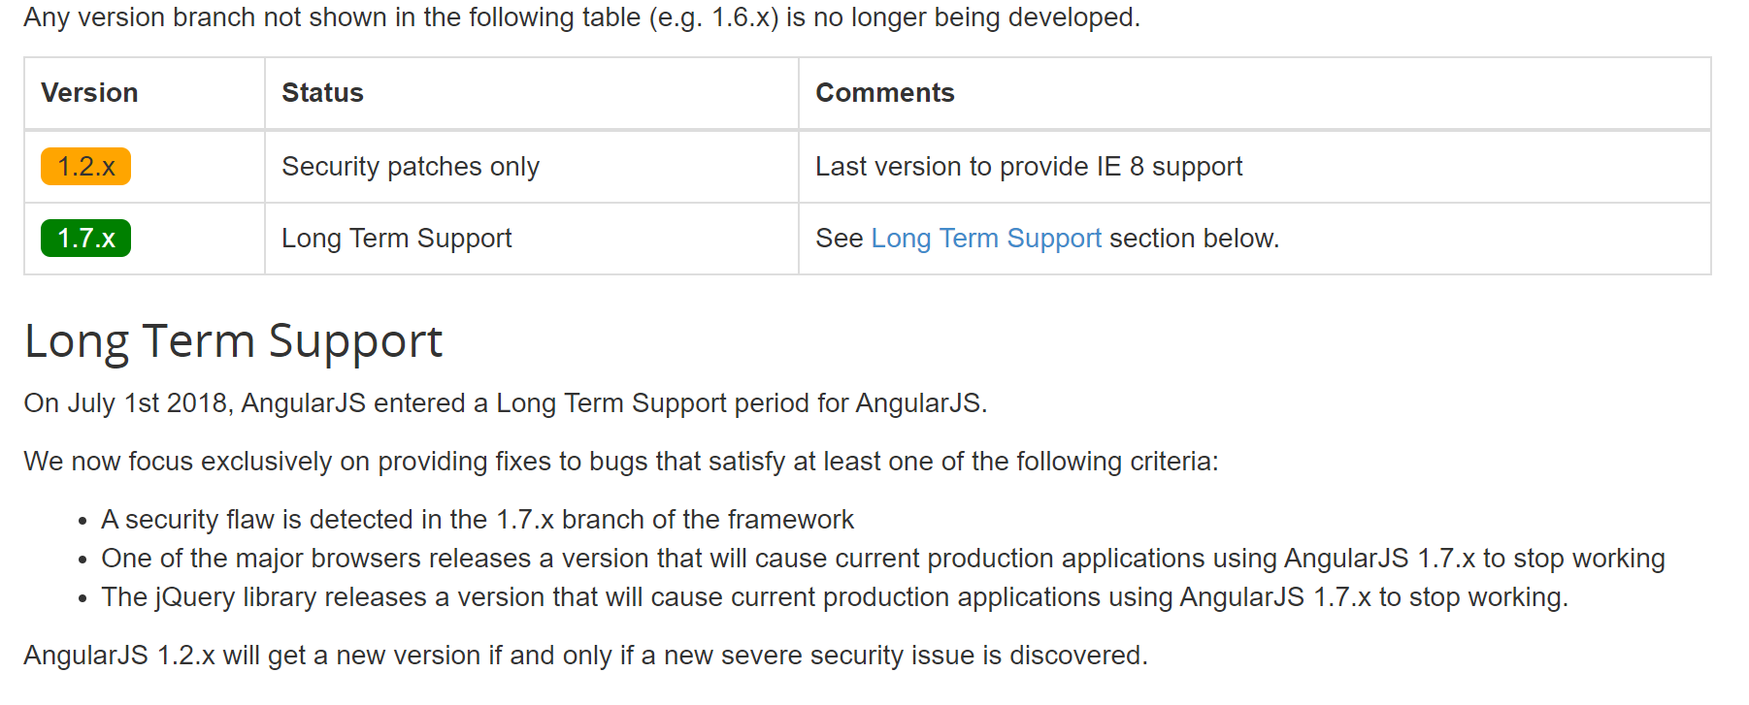
To rewrite or not to rewrite
AngularJS End-of-life
  Long-term-support July 1st, 2018 - July 1st, 2021
  https://docs.angularjs.org/misc/version-support-status#long-term-support
    https://bit.ly/2LXU89J

Slide 10
To rewrite or not to rewrite
State of our code
  Built in under 2 months
    Single developer
    Lack of best practices
  No Documentation
  No Unit/E2E testing
  Tightly coupled to legacy SDK
    Deprecated with shift to native apps

Slide 11
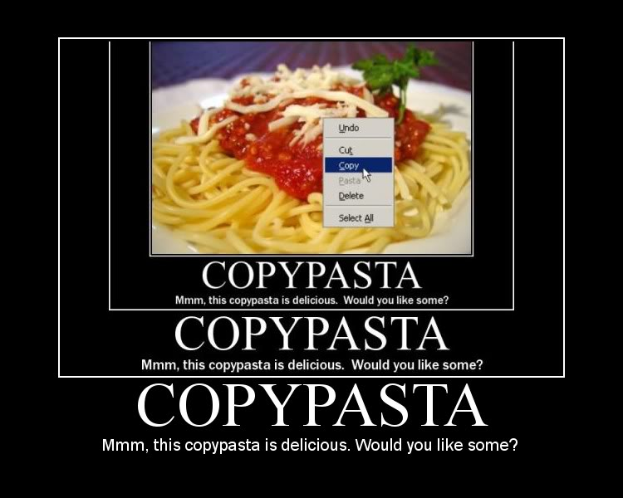
To rewrite or not to rewrite
Developer quality of life
  Lack of build system
  Debugging Difficult
  Business rules undocumented
  Susceptible to side effects
  Lack of quality dev tools
  Copy/Pasta’d code and CSS

Slide 12

Cost of a rewrite

Slide 13
Cost of a rewrite
Onboarding
  3-6 months before experienced engineers become productive
  Juniors struggle
New Features
  From design to production
    Started 2-3 months
    Ended 6-9 months

Slide 14
Cost of a rewrite
Supporting Existing Features
  Increase in
    Bugs reported
    LSI’s
    Error Rates
    Time to diagnose/deloy fix

Slide 15
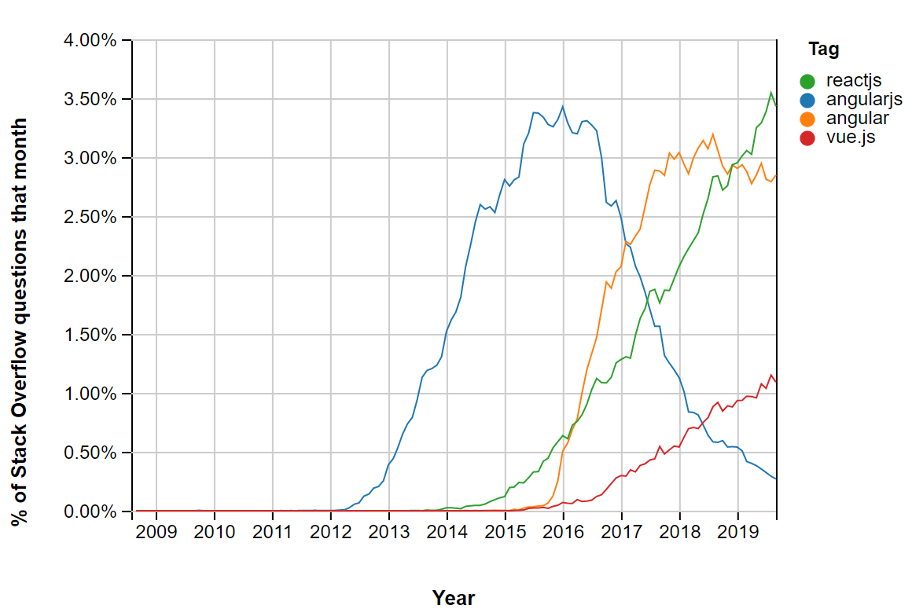
Cost of a rewrite
Attracting Talent
  Growth Period
  Attracting top talent difficult
    Older tech not attractive
Source: Stack Overflow - https://bit.ly/2OR4Wse

Slide 16
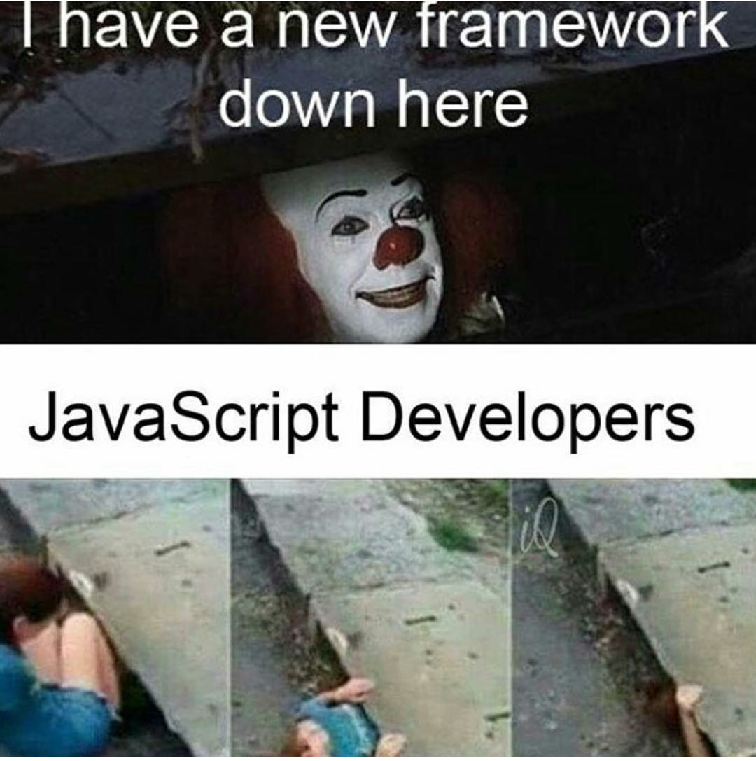
How we decided on Vue.js

Slide 17



Selection Process
3 Frameworks
  React
  Angular 5
  Vue.js
Centralized State
  Flux/Redux/Vuex
Proof of concept
  Auction List

Slide 18
Vue.js
Pros
  Similar syntax
    v-if/ng-if
    v-show/ng-show
    v-for/ng-for
  Ease of setup and deployment
    Vue CLI
  Single file components
    Single responsibility
    Easier re-use

Slide 19
Vue.js
Cons
  Not developed by a major company
  Not as widely adopted as React or Angular
  Large scale applications can become difficult to maintain/manage

Slide 20

Measuring Success (and failure)

Slide 21

Measuring Success
Define and honor a delivery date
  July 22 2019
  Deliver within 1 week of committed delivery date

Slide 22
Measuring Success
Improve app performance
  Page load times < 1 second
  APDEX
    Set for 2 seconds
  BrowserInteraction duration
    3 seconds

Slide 23
Measuring Success
Observe Error Budget
  1 or fewer LSI’s during life of project

Slide 24
Measuring Success
Generate Robust documentation
  Implement Storybook component library
    Include documents on each component
  Documentation generated for each release

Slide 25
Measuring Success
Improve unit test coverage
  > 30%

Slide 26
Our Architecture

Slide 27
Legacy System
Grunt
  Uglify minified static assets
  Manually linked JS/CSS
Web servers
  Load Balanced
  Docker containers
    NGINX
    PHP

Slide 28
Legacy System
Redis instance
  Session Data
Client storage
  PHP cookie for session data
  localStorage for misc data

Slide 29
Vue System
Vue CLI 3
  Webpack 4
  Babel
  .env configs
Web servers
  Load Balanced
  Docker containers
    NGINX
Service Worker/PWA Support
  Pre-cache static assets
  Handles application updates.

Slide 30
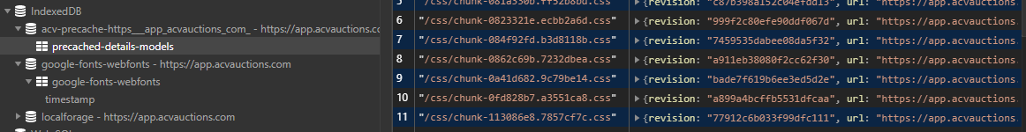
Vue System
Client Storage
  localStorage
  IndexDB
    Service worker cache

Slide 31

Angular/Vue Integration

Slide 32
Integration
Git submodule
  Vue repo as submodule of Angular repo
  Clear separation of legacy code
  No risk of accidental coupling
  Can expose Vue components to Angular

Slide 33
Integration
Git submodule
  Separate deployments
  Easier local development
  Cleaner cutover once migration is complete.
    Less tech debt.

Slide 34
Integration
Feature Development
  All new features in Vue
    Limit feature duplication when possible
  Expose Vue components via iframe
    Components prop-based (no Vuex)
    Window events for communication
      Ex: AMP Audio Player

Slide 35
Integration
Service Worker
  Vue CLI PWA plugin
  Pros:
    Cache layer
      Improve load times
    Background updates
      Prompt for reload
      Force refresh

Slide 36
Integration
Service Worker
  Cons:
    Increased complexity
    Difficult to debug/test

Slide 37

OKR Results

Slide 38

OKR Results
Define and honor a delivery date
  July 22 2019
  Deliver within 1 week of committed delivery date
Result:
  Sept. 10th 2019

Slide 39

Measuring Success
Improve app performance
  Page load times < 1 second
  APDEX
    Set for 2 seconds
  BrowserInteraction duration
    3 seconds
Results:
  Time-to-first-byte
    0.1 - 0.3 secs
    3-4 seconds total
  APDEX
    0.75
  BrowserInteraction duration
    5.89 seconds

Slide 40

Measuring Success
Observe Error Budget
  1 or fewer LSI’s during life of project
Results
  1 LSI
    SEV 3

Slide 41
Measuring Success
Generate Robust documentation
  Implement Storybook component library
    Include documents on each component
  Documentation generated for each release
Results:
  Completed
    Internally hosted
  Completed
    Release document generator

Slide 42

Measuring Success
Improve unit test coverage
  > 30%
Results:
  43%

Slide 43

Summary

Slide 44

Tom Colarusso
@etcolarusso
@acvauctions
Questions?
www.acvauctions.com

